Slide 2
Tour And Travel Booking System
Submitted to: Prof. Nivedita Tiwari
Department of Information Technology

Slide 3
Supervised by: Prof. Brajesh Chaturvedi
Team Members
1. Anuj Mishra(0827IT211015)
2.Harsh Machiya (0827IT211040)
3.Chirag Malviya (0827IT211031)

Slide 4
Abstract
A tour and travel booking system project is a software Website designed to streamline the process of planning and booking trips and vacations. It enables travelers to search for destinations, compare prices, view itineraries, and make reservations for flights, accommodations, transportation, and activities all in one convenient platform. Additionally, it often includes features such as user profiles, payment processing, and real-time availability updates to ensure a seamless and hassle-free travel booking experience for both customers and travel providers.

Slide 5
Introduction
“Effortless Travel Planning: The Tour and Travel Booking System Project”. A tour and travel booking system project is a technology-driven solution designed to simplify and enhance the process of planning, booking, and managing travel experiences for individuals and groups. This project aims to provide a comprehensive platform that connects travelers with a wide range of travel services, including flights, accommodations, transportation, tours, and activities. The system offers numerous features such as real-time availability, price comparison, user reviews, secure payment processing, and personalized itinerary planning.

Slide 6
The Problem Statement
Inefficient Booking Process: Travelers struggle with a complex and time-consuming booking process for flights, accommodations, and activities, leading to frustration and a poor user experience.
Lack of Comprehensive Travel Information: Travelers find it challenging to access up-to-date and comprehensive information about destinations, including attractions, accommodations, and local events.
Limited Access to Local Experiences: Tourists miss out on authentic local experiences due to a lack of access to local guides, tours, and cultural activities.
Safety and Security Concerns: Travelers express concerns about safety and security while traveling, including travel advisories, emergency support, and risk mitigation.
Hidden Fees and Unexpected Costs: Travelers encounter hidden fees and unexpected costs when booking, leading to budget overruns and dissatisfaction.

Slide 7
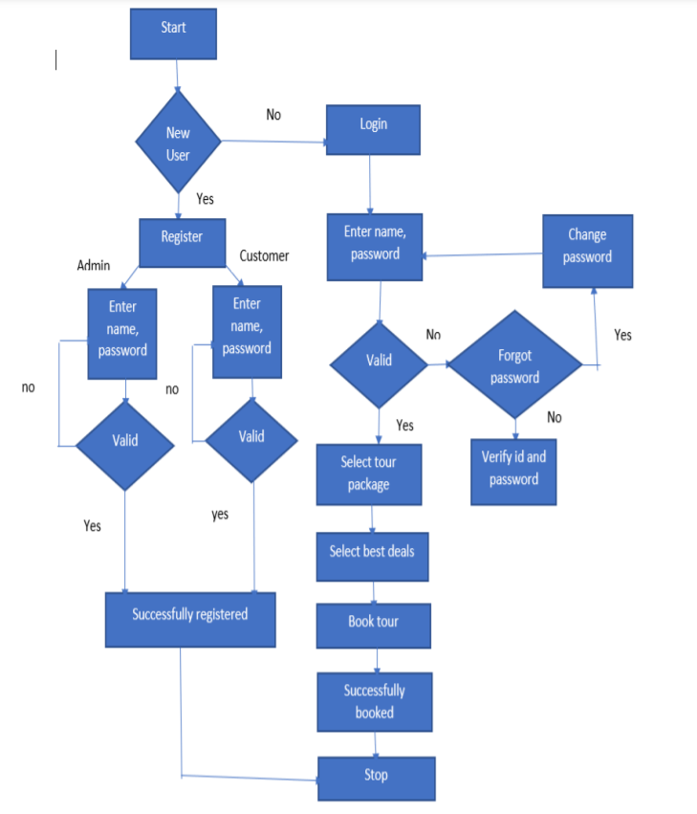
Block Diagram

Slide 8
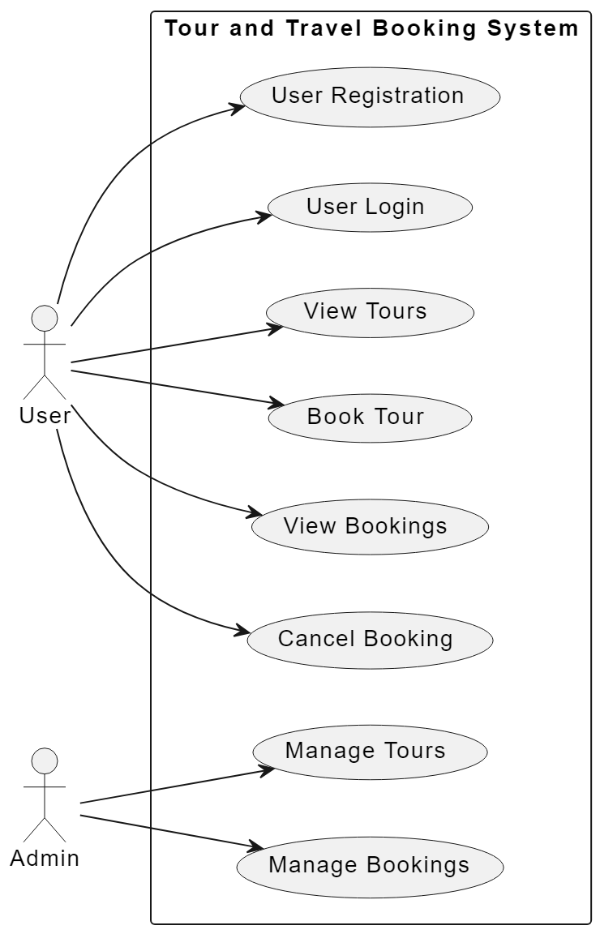
Use Case Diagram

Slide 9
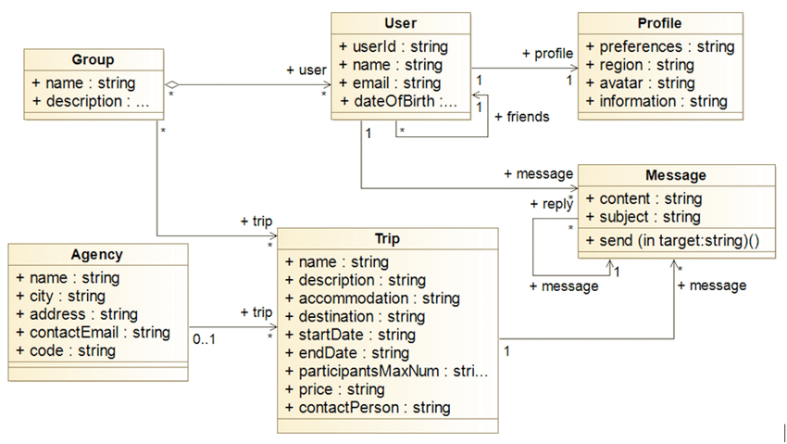
Class Diagram

Slide 10
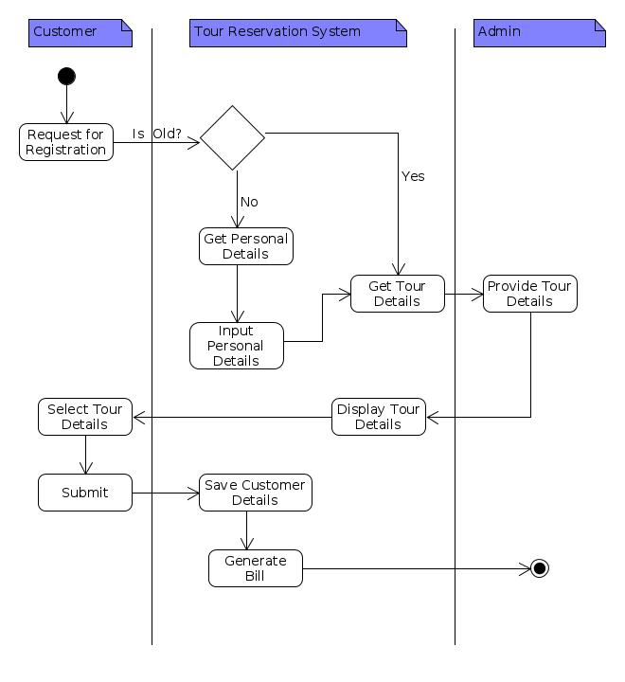
Activity Diagram

Slide 11
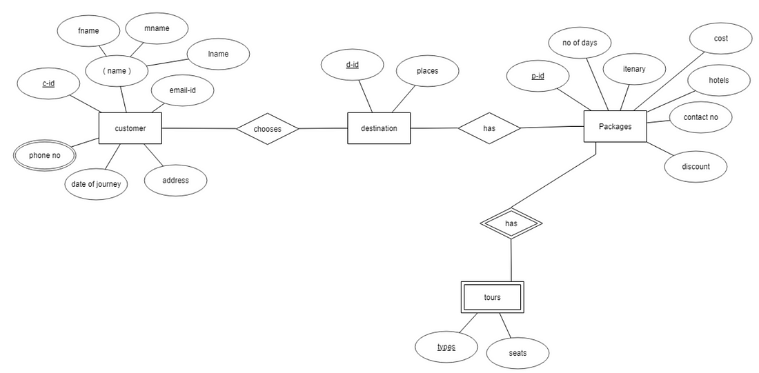
E-R Diagram

